Slide 1

ROC Curve Estimation and Fitting Algorithms
Gia Smith
University of Virginia
Ph.D. Student Showcase
08/17/2023

Slide 2

01.
What is a ROC Curve?
02.
ROC Models
03.
Fitting Algorithms
04.
Final Thoughts
Agenda

Slide 3
01.
What is a ROC Curve?

Slide 4
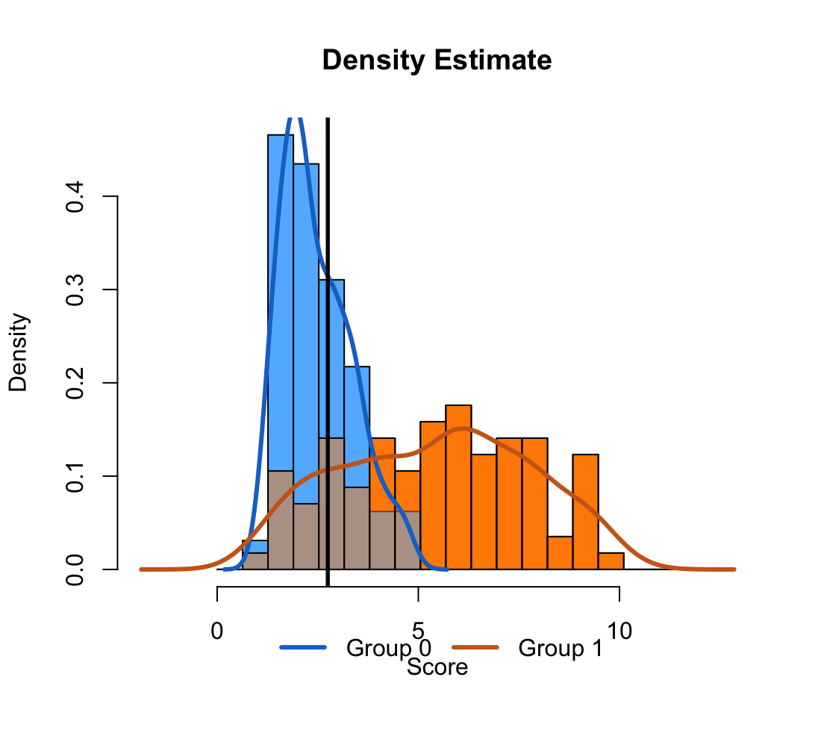
Cancer Serum Biomarker Data
Pancreatic Cancer
Cancer Antigen 199 (CA199)
141 Individuals
90 cases
51 control
Wieand et al. (1989) Biometrika 76(3):585-592

Slide 5
Cancer Serum Biomarker Data
Pancreatic Cancer
Cancer Antigen 199 (CA199)
141 Individuals
90 cases
51 control
Wieand et al. (1989) Biometrika 76(3):585-592
c = 2.75
P(score > 2.75 | Blue) = 0.33
P(score > 2.75 | Orange) = 0.63

Slide 6
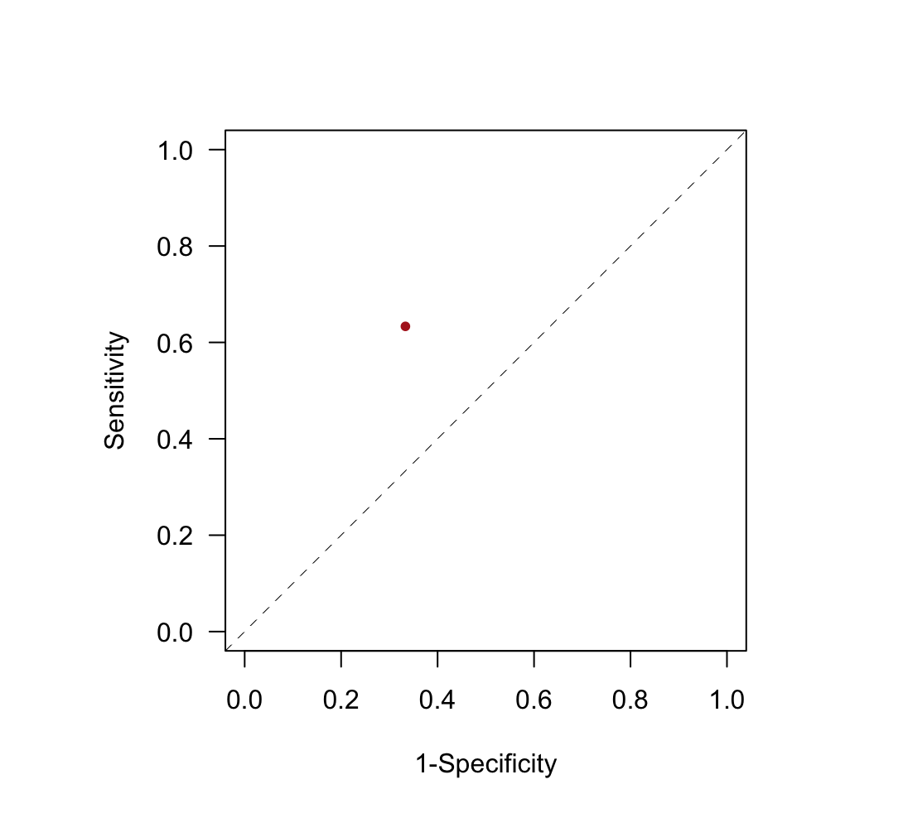
c =2.75

Slide 7
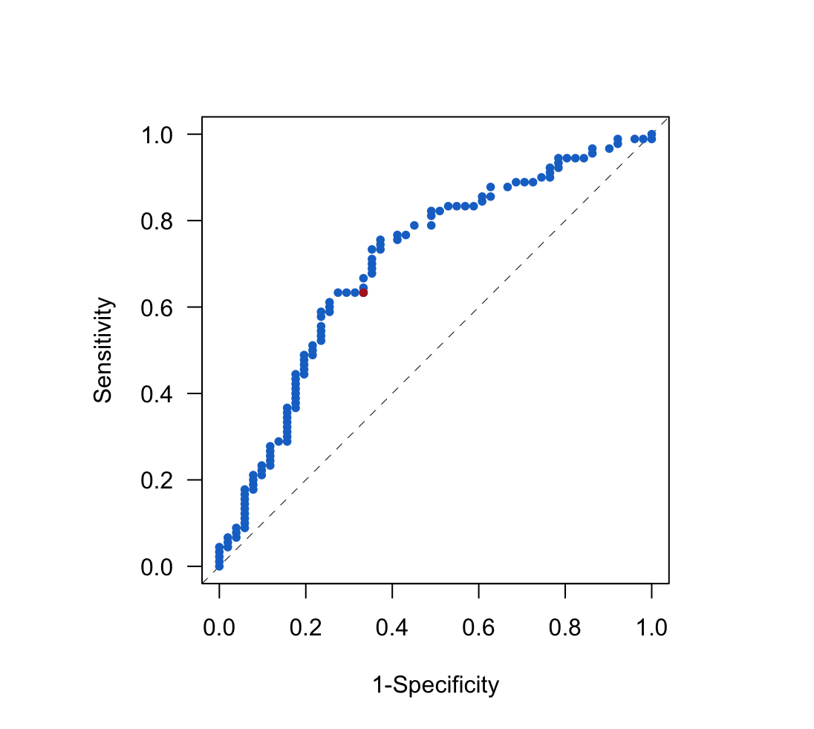
Empirical ROC

Slide 8
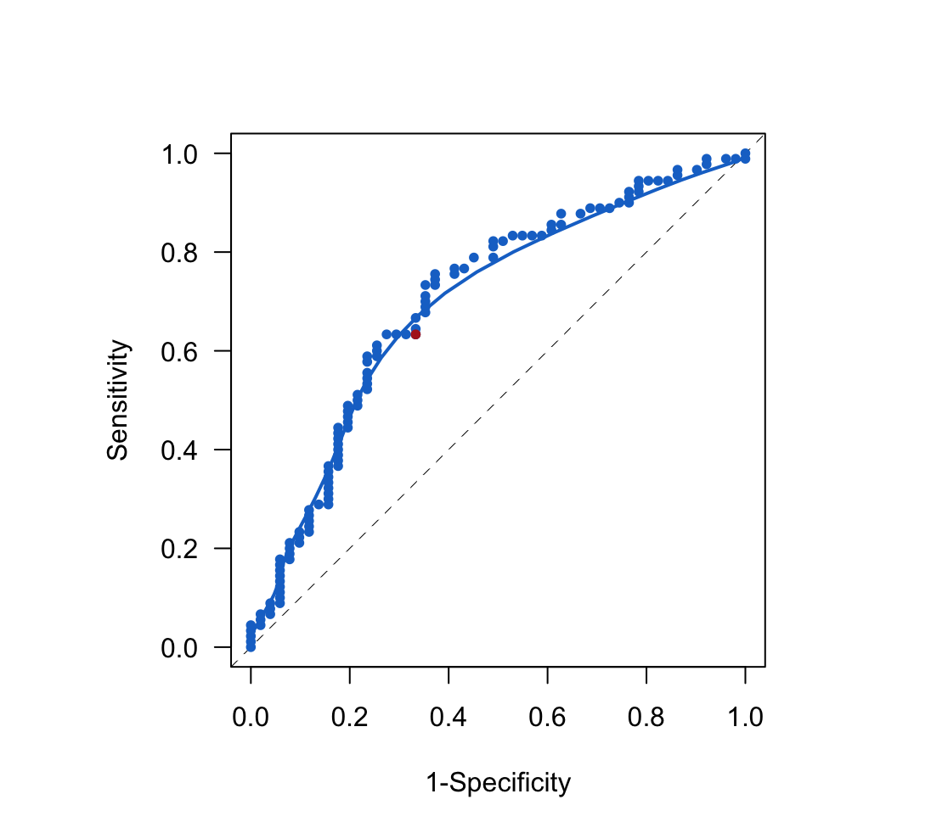
Empirical ROC
with smoothed curve
Goal is to model
the smooth curve

Slide 9
02.
ROC Models

Slide 10

ROC Models
Postulates a linear relationship between the quantiles of the two groups
Sensitivity and specificity are linearly related in quantile-quantile space
Want to estimate intercept (a) and slope (b) of relationship
$$Sen\left(c\right)=P\left(score>c | Group 1\right)$$
$$Spec\left(c\right)=P(score<c|Group 0)$$
$$F_{1}^{−1}\left[Sens(c)\right]=a+b F_{0}^{−1}[1−Spec(c)]$$
$$Normal model example:$$
$$Φ^{−1}\left[Sens(c)\right]=a+b Φ^{−1}[1−Spec(c)]$$

Slide 11
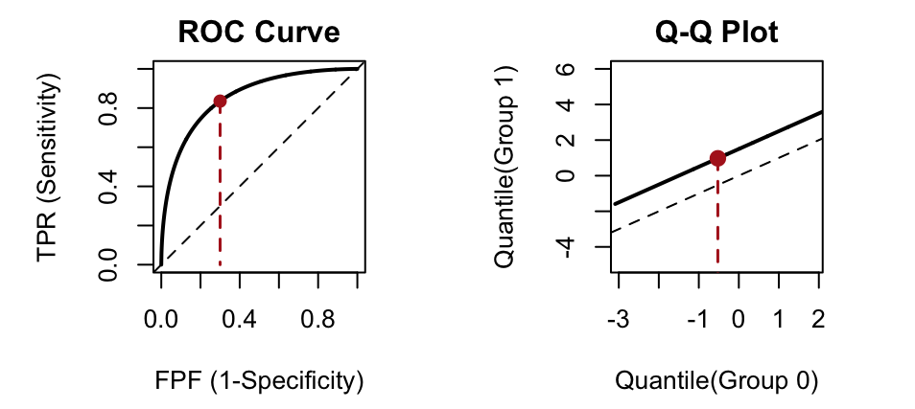
Notes:
Fix the scale of the density plots to see legend

Slide 12
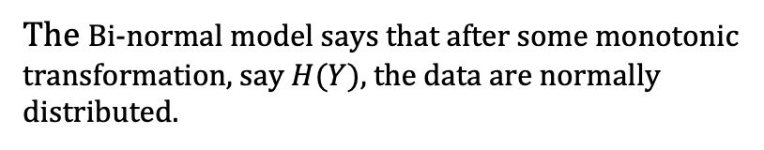

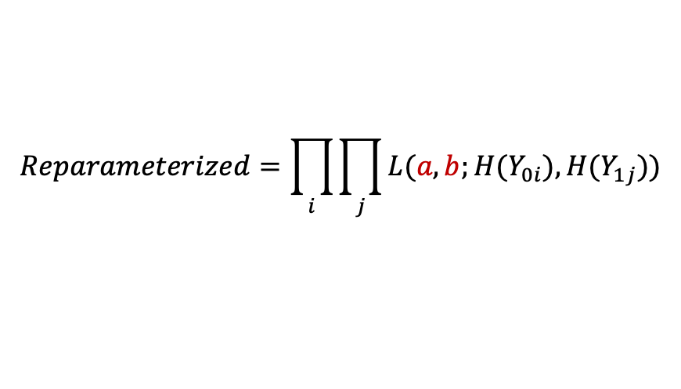
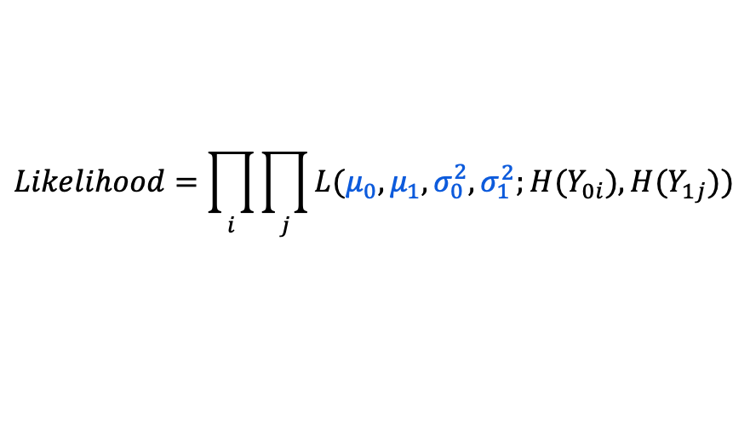
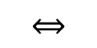
ROC Models: Bi-normal model
$$H\left(Y_{01}\right),…,H\left(Y_{0n}\right) \sim N(μ_{0},σ_{0}^{2})$$
$$H\left(Y_{11}\right),…,H\left(Y_{1m}\right) \sim N(μ_{1},σ_{1}^{2})$$
The Bi-normal model says that after some monotonic transformation, say $H(Y)$, the data are normally distributed.
$$⟺$$
$$Likelihood=\prod_{i}{\prod_{j}{L(μ_{0},μ_{1},σ_{0}^{2},σ_{1}^{2};{H(Y}_{0i}),{H(Y}_{1j}))}}$$
Data Parameters
Maximum Likelihood Estimation
often works
$$Reparameterized=\prod_{i}{\prod_{j}{L(a,b;{H(Y}_{0i}),{H(Y}_{1j}))}}$$
ROC Parameters
Maximum Likelihood Estimation
sometimes works
Notes:
Goal is to find the parameters a and b which are closely related to $μ_{0},μ_{1},σ_{0}^{2},σ_{1}^{2}$.
Replace 11

Slide 13
03.
Fitting Algorithms

Slide 14
Fitting Algorithms
Fitting Algorithms for Estimating Data and ROC Parameters
Maximum likelihood estimation is straightforward but is hard to implement (or fails) when the likelihood surface is not convex.
Various versions of Gradient Descent (GD) might solve this problem
Variations we are exploring:
Vanilla-flavored Gradient Descent
Stochastic Gradient Descent (SGD) with/out Mini-Batching
SGD with Enhancement such as Momentum
Notes:
Goal is to find the parameters a and b which are closely related to $μ_{0},μ_{1},σ_{0}^{2},σ_{1}^{2}$.
Replace 11

Slide 15
04.
Final Thoughts

Slide 16
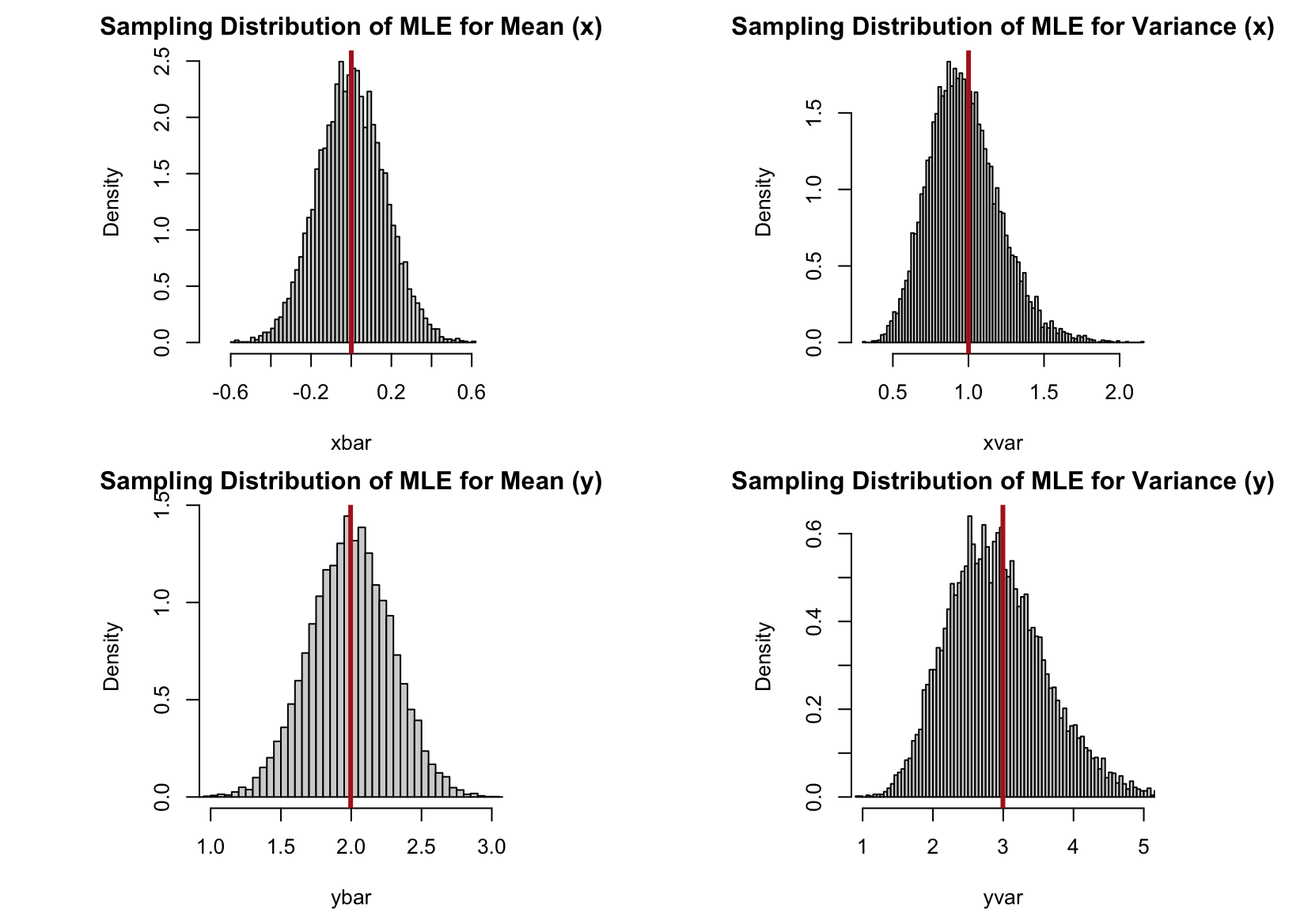
Notes:
Fix the scale of the density plots to see legend

Slide 17
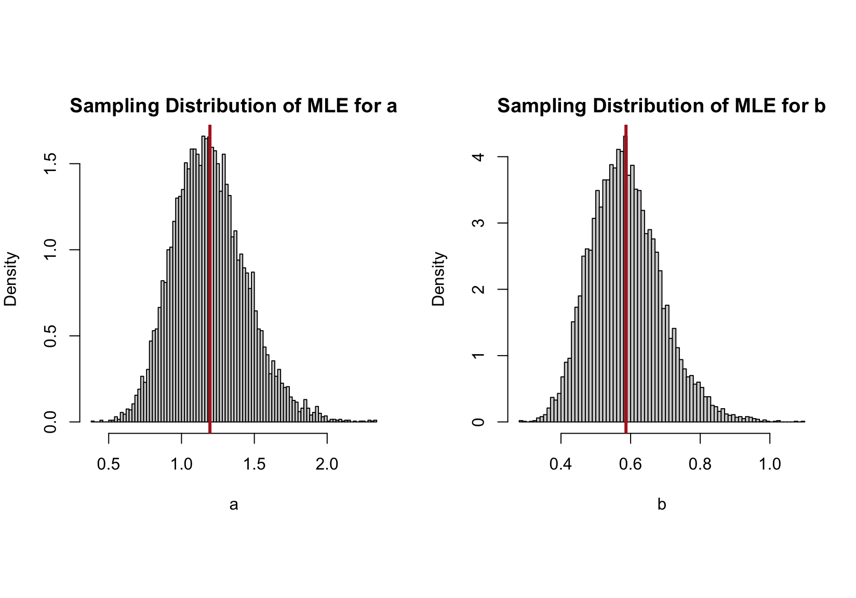
Notes:
Fix the scale of the density plots to see legend

Slide 18
Questions?

Slide 19
Cancer Serum Biomarker Data
Cancer Antigen 199 (CA199)
Pancreatic Cancer
141 Individuals
90 cases (Orange)
51 control (Blue)
Wieand et al. (1989)
Biometrika 76(3):585-592
c = 2.75

Slide 20

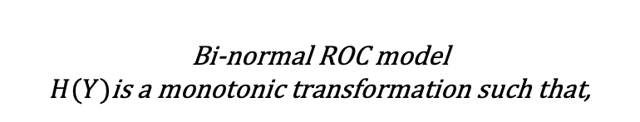
Complexity of ROC Models
Bi-normal ROC model
$H(Y)$is a monotonic transformation such that,
$$H(Y_{01}),…,H(Y_{0n})\sim N(μ_{0},σ_{0}^{2})$$
$$H(Y_{11}),…,H(Y_{1m})\sim N(μ_{1},σ_{1}^{2})$$
Notes:
Goal is to find the parameters a and b which are closely related to $μ_{0},μ_{1},σ_{0}^{2},σ_{1}^{2}$.
Move

Slide 21
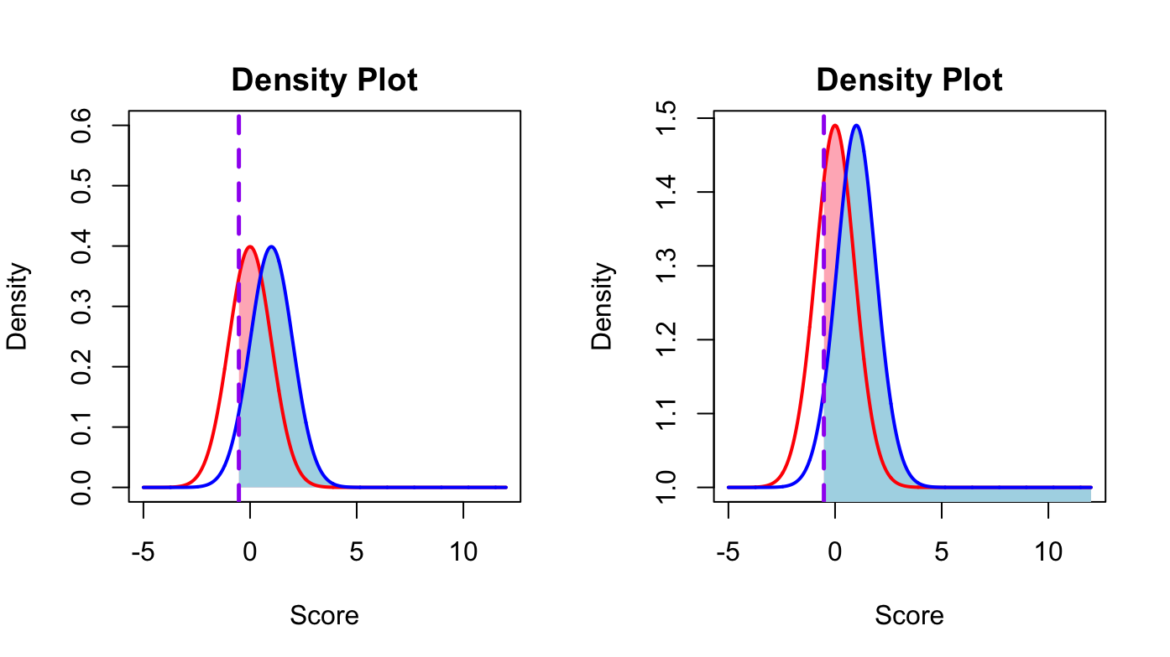
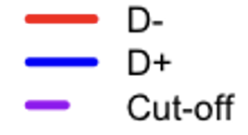
Normal
Exponentiated
Notes:
Move

Slide 22
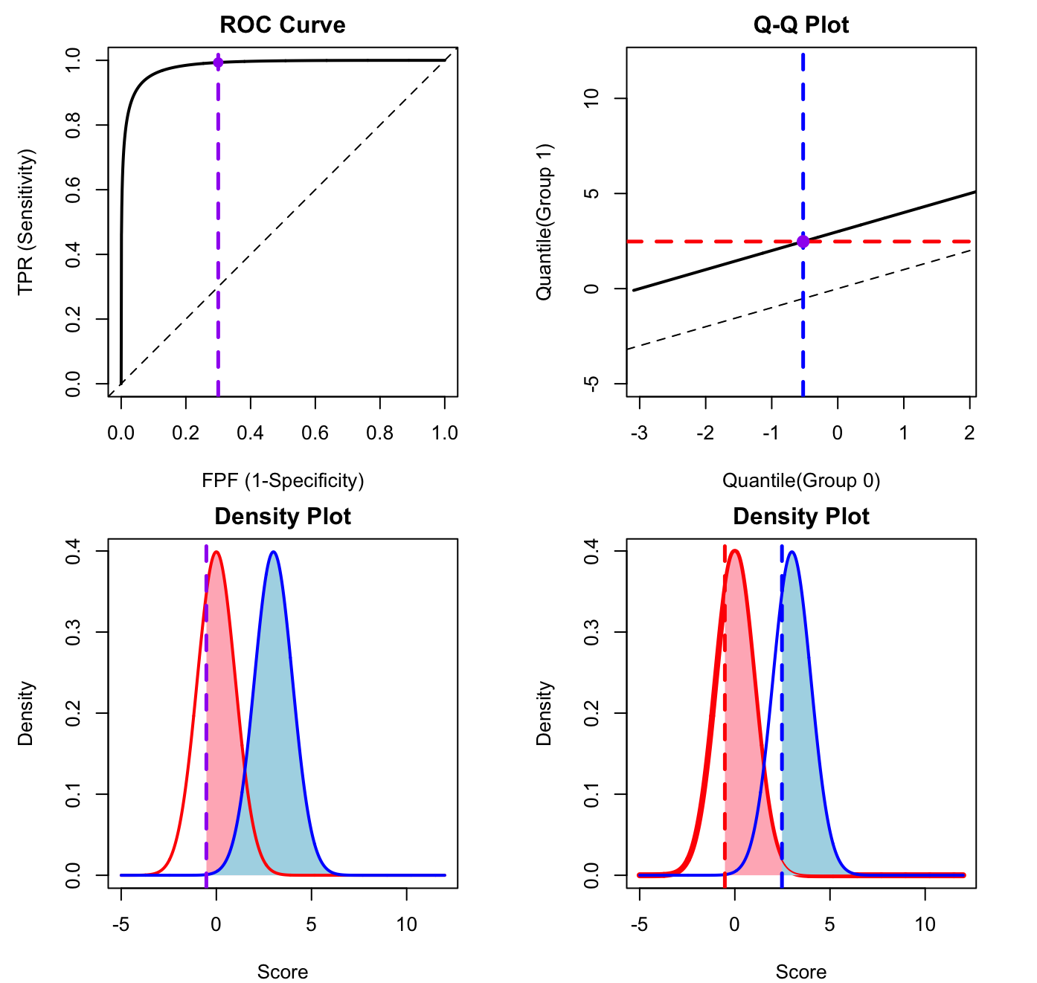
Notes:
Fix the scale of the density plots to see legend
Move

Slide 23
Notes:
Fix the scale of the density plots to see legend

Slide 24

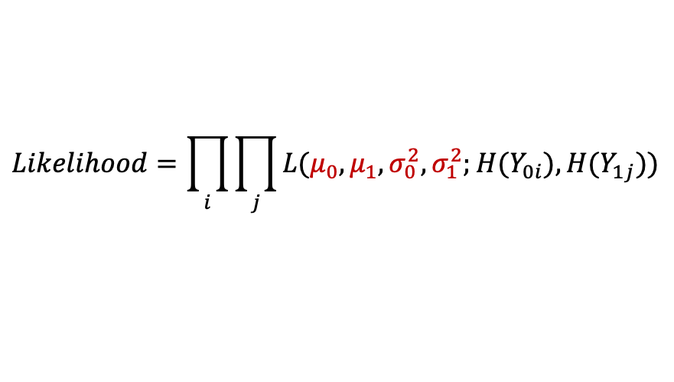
ROC Models: Bi-normal model
$$H\left(Y_{01}\right),…,H\left(Y_{0n}\right) \sim N(μ_{0},σ_{0}^{2})$$
$$H\left(Y_{11}\right),…,H\left(Y_{1m}\right) \sim N(μ_{1},σ_{1}^{2})$$
The Bi-normal model says that after some monotonic transformation, say $H(Y)$, the data are normally distributed.
$$⟺$$
$$Likelihood=\prod_{i}{\prod_{j}{L(μ_{0},μ_{1},σ_{0}^{2},σ_{1}^{2};{H(Y}_{0i}),{H(Y}_{1j}))}}$$
Data Parameters
Maximum likelihood estimation works
$$Reparameterized=\prod_{i}{\prod_{j}{L(a,b;{H(Y}_{0i}),{H(Y}_{1j}))}}$$
ROC Parameters
Maximum likelihood estimation sometimes works
$If H\left(Y\right)=Y, then a=\frac{{μ_{1}−μ}_{0}}{σ_{1}} and$ $b=\frac{σ_{0}}{σ_{1}}$ Otherwise, it is not so simple!
Notes:
Goal is to find the parameters a and b which are closely related to $μ_{0},μ_{1},σ_{0}^{2},σ_{1}^{2}$.
Replace 11

Slide 25
Initialize Parameters:
Set initial means (mu) and standard deviations (sd) for two populations.
Compute True Parameters:
Calculate parameters 'a' and 'b' based on true population values.
Generate Data:
Generate data for populations x0 and x1.
Set Hyperparameters:
Define learning rate (alpha), tolerance (tol), iterations (iter), batch sizes, and momentum coefficient.
Initialize Count and Parameters:
Initialize iteration count and parameter estimates.
Loop Over Batch Sizes:
For each batch size, perform the following steps:
Initialize Batch Indices: Split data into batches and calculate batch indices.
Initialize Loss Vectors: Create vectors to store loss values.
Loop Over Iterations:
For each iteration, update parameter estimates and calculate losses for both populations.
Store losses in respective vectors.
Check for convergence and update count.
Check for non-convergence.
Create Loss Data Frame:
Create a data frame to store loss data over epochs and batch sizes.
End of Flow Chart
Notes:
Fix the scale of the density plots to see legend

